Slide 2
1 - Be Still and Know
1.
Be still and know that I am God.
Be still and know that I am God.
Be still and know that I am God.
Words by: from Psalms 46:10 and Exodus 15:26
Music by: Anonymous
© 2001 The Paperless Hymnal™

Slide 3
1 - Be Still and Know
© 2001 The Paperless Hymnal™

Slide 4
2 - Be Still and Know
2.
I am the Lord that strengthens thee.
I am the Lord that strengthens thee.
I am the Lord that strengthens thee.
Words by: from Psalms 46:10 and Exodus 15:26
Music by: Anonymous
© 2001 The Paperless Hymnal™

Slide 5
2 - Be Still and Know
© 2001 The Paperless Hymnal™

Slide 6
1 He Has Made Me Glad
He Has Made Me Glad

Slide 7
2 He Has Made Me Glad
He Has Made Me Glad

Slide 8
3 He Has Made Me Glad
He Has Made Me Glad

Slide 9
4 He Has Made Me Glad
He Has Made Me Glad

Slide 10
1 He Has Made Me Glad
He Has Made Me Glad

Slide 11
2 He Has Made Me Glad
He Has Made Me Glad

Slide 12
3 He Has Made Me Glad
He Has Made Me Glad

Slide 13
4 He Has Made Me Glad
He Has Made Me Glad

Slide 14
1-1 How Great is Our God
How Great Is Our God

Slide 15
1-2 How Great is Our God
How Great Is Our God

Slide 16
C How Great is Our God
How Great Is Our God

Slide 17
2-1 How Great is Our God
How Great Is Our God

Slide 18
2-2 How Great is Our God
How Great Is Our God

Slide 19
C How Great is Our God
How Great Is Our God

Slide 20
C How Great is Our God
How Great Is Our God

Slide 21
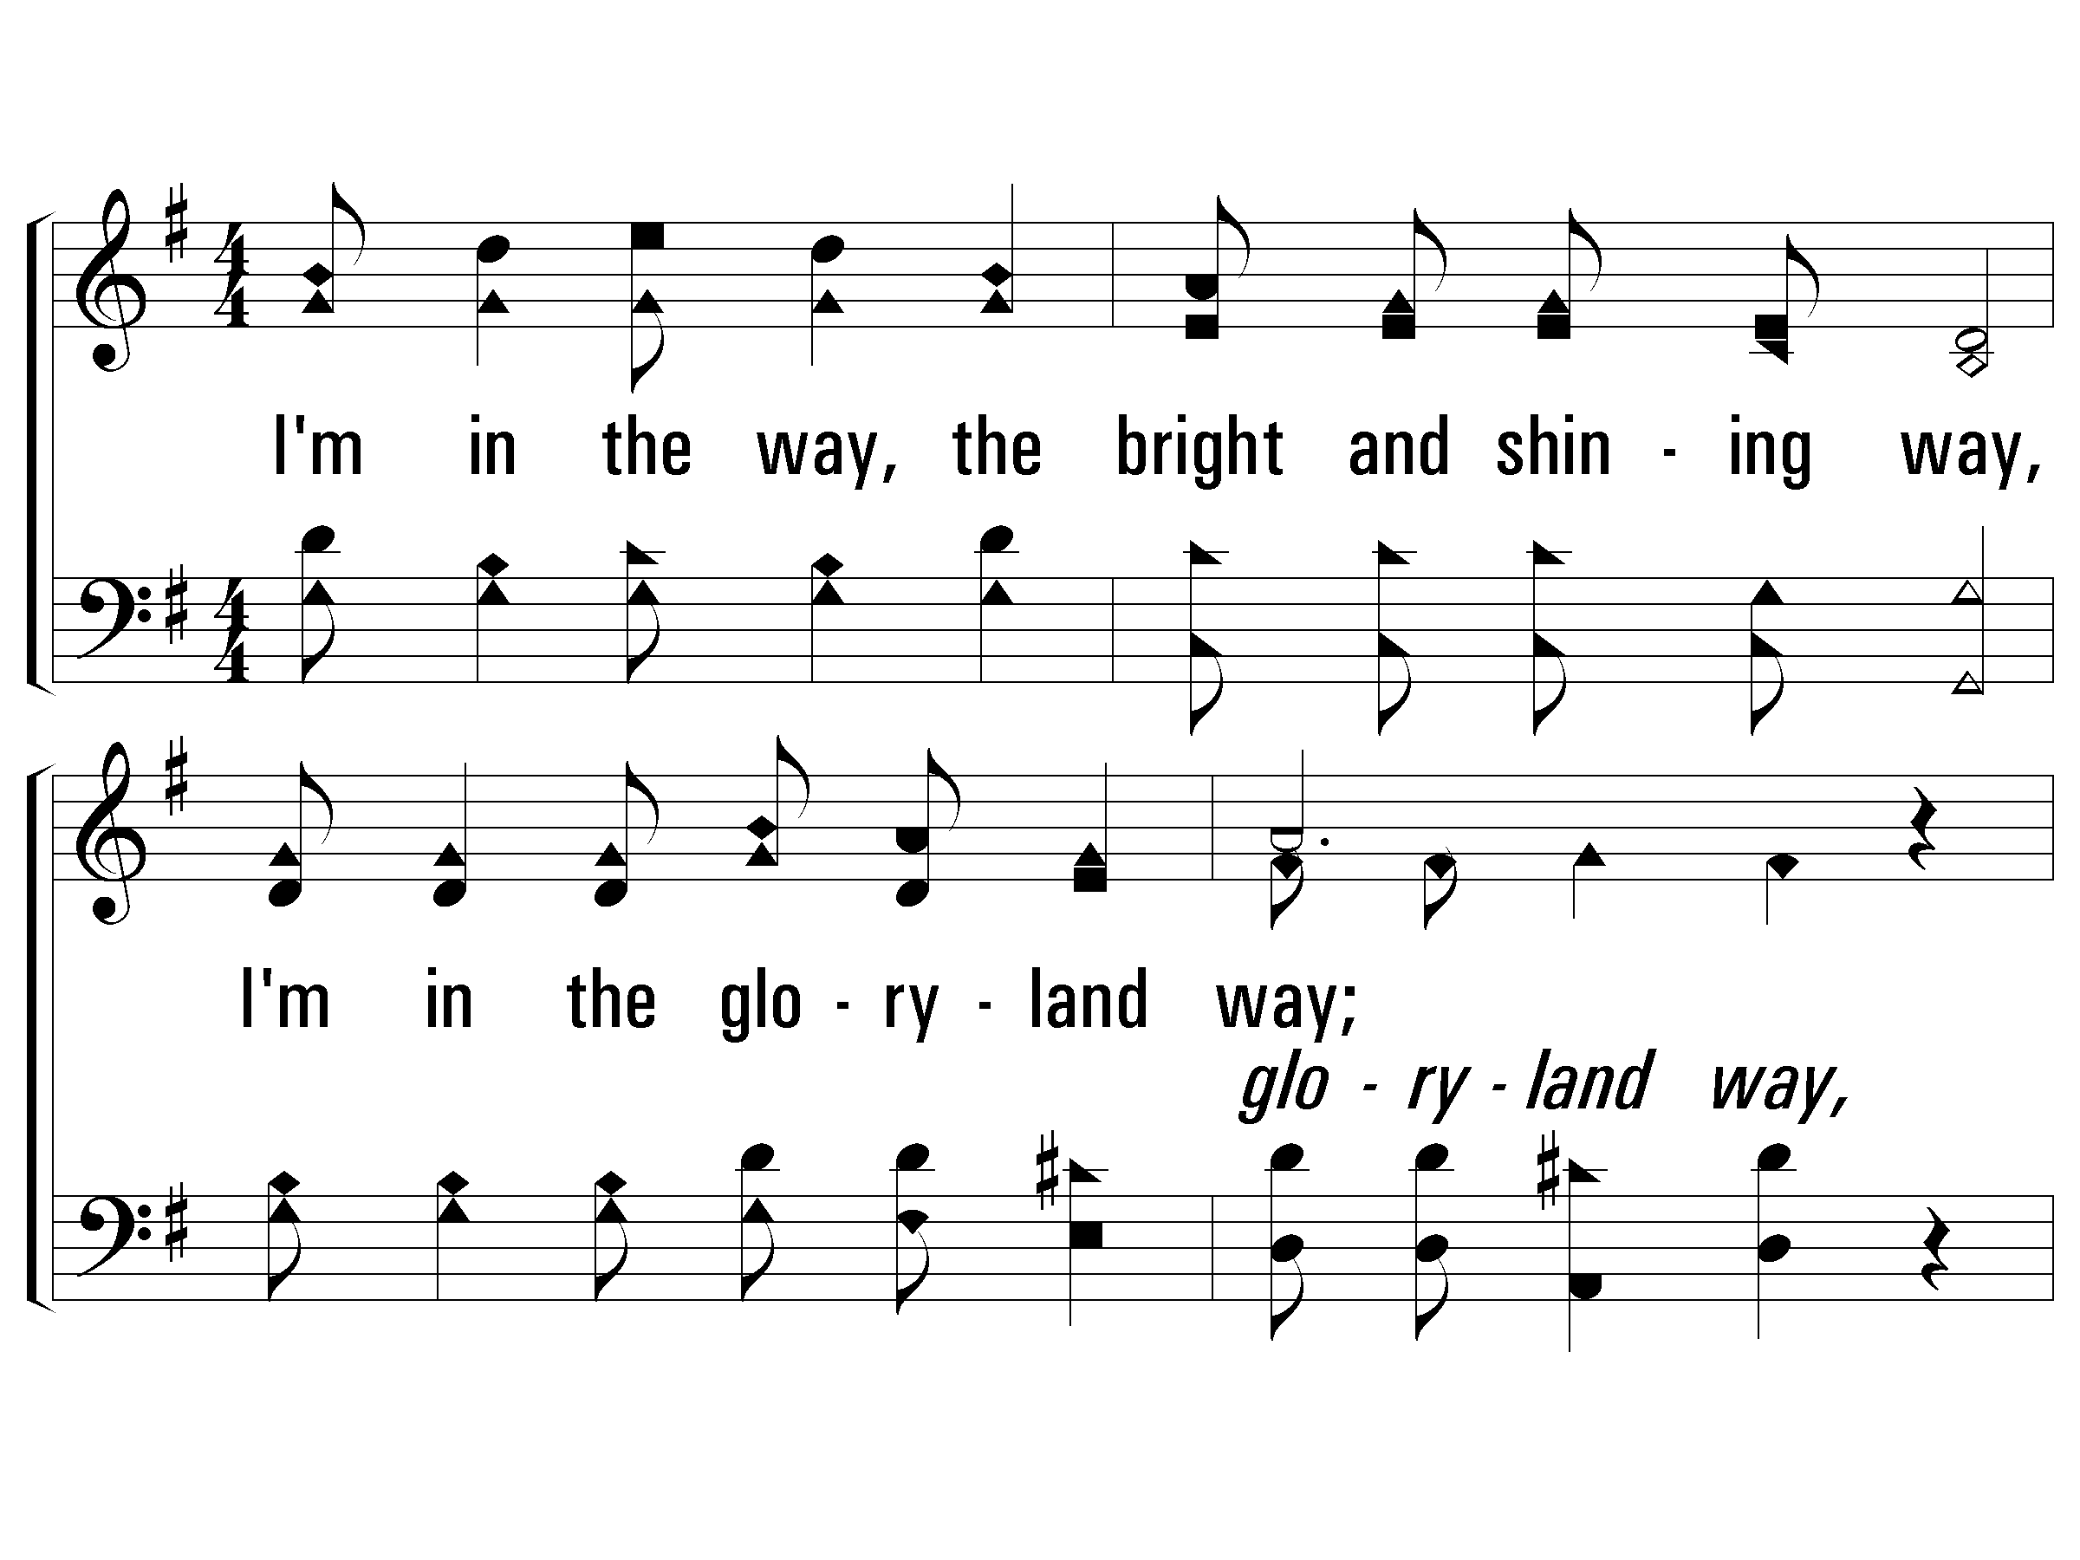
1 – The Glory-Land Way
1.
I'm in the way, the bright and shining way,
I'm in the gloryland way;
Telling the world that Jesus saves today,
Yes, I'm in the gloryland way.
Words and Music by: J. S. Torbett
© 2001 The Paperless Hymnal™

Slide 22
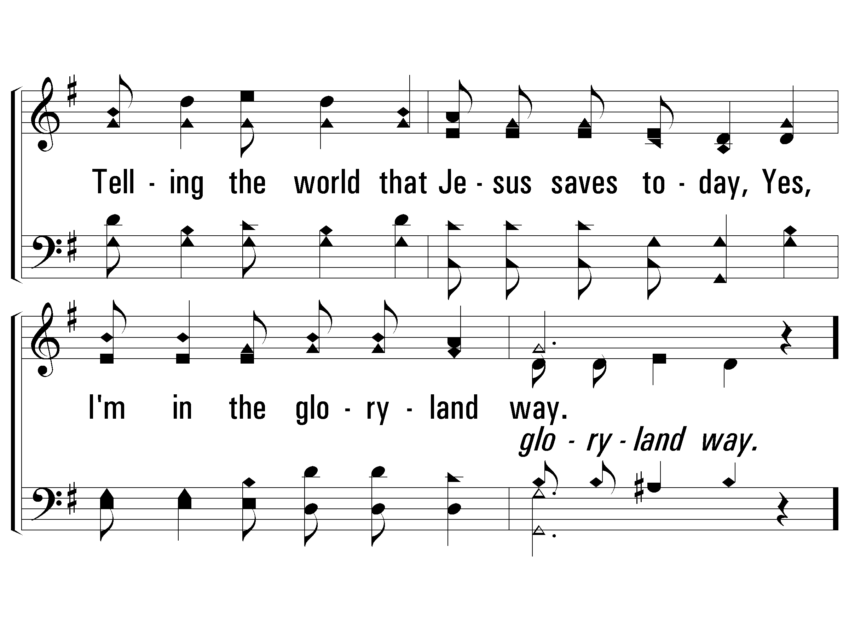
1 – The Glory-Land Way
© 2001 The Paperless Hymnal™

Slide 23
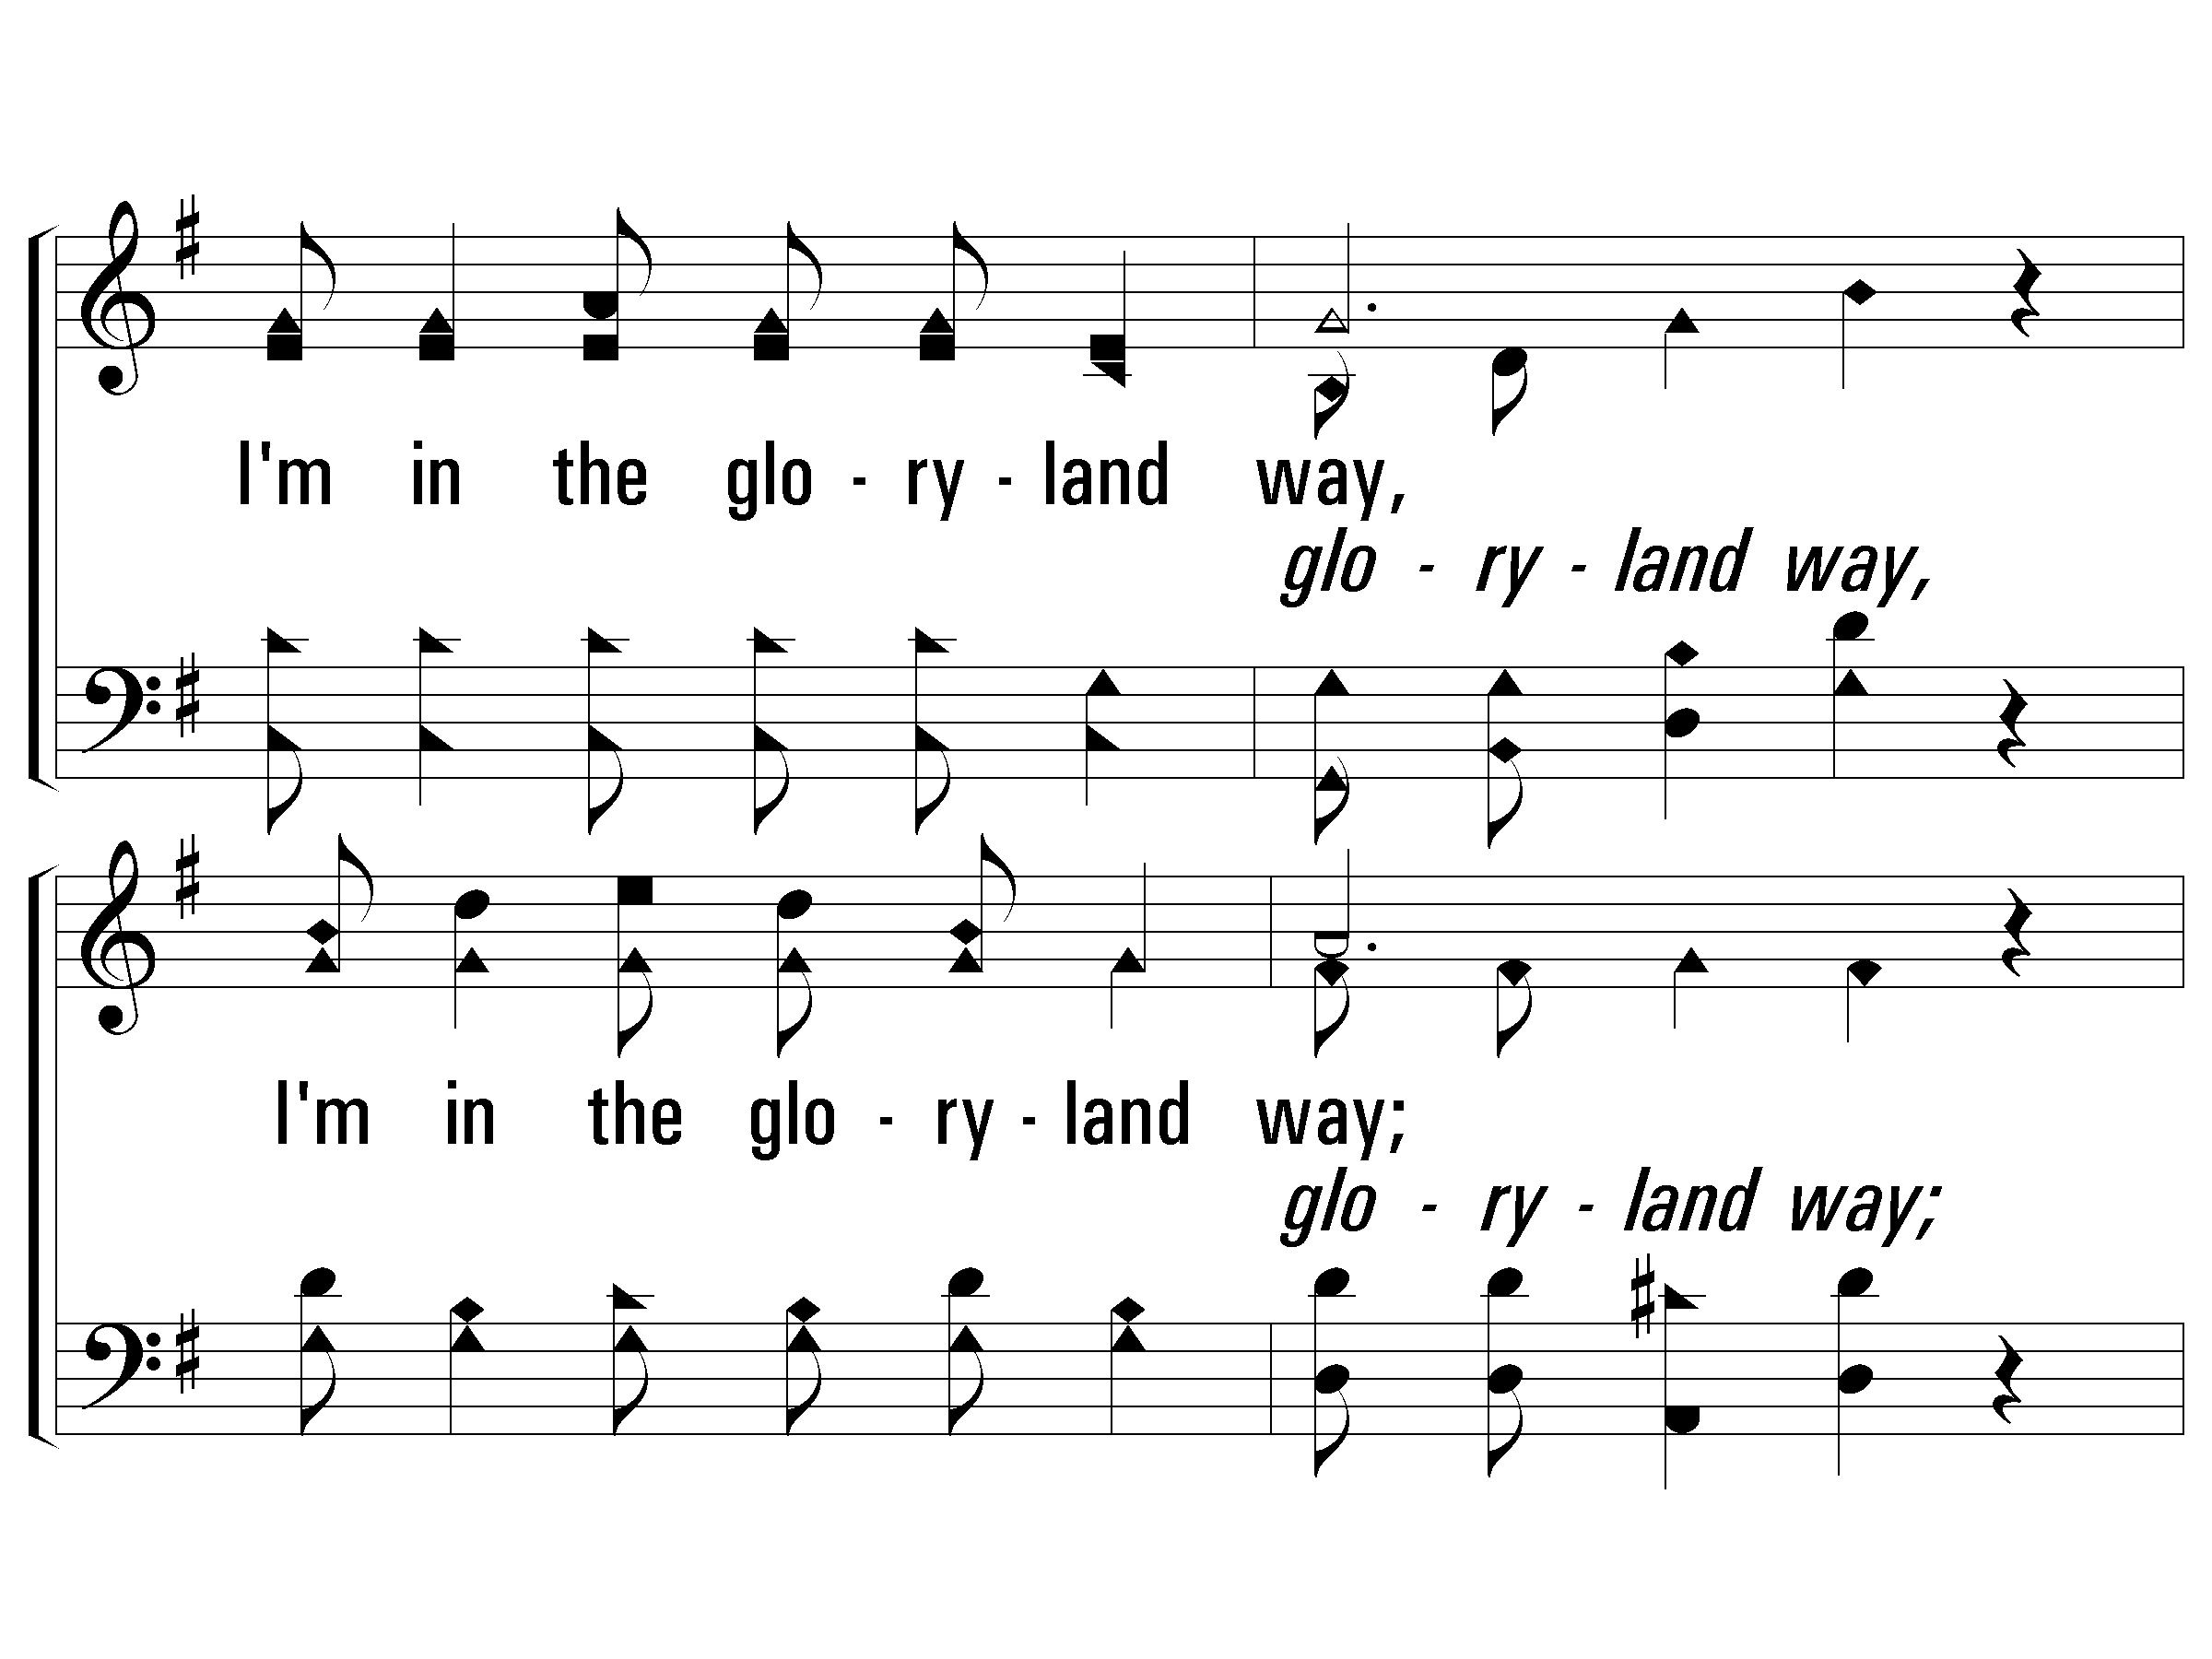
c – The Glory-Land Way
I'm in the gloryland way,
I'm in the gloryland way;
Heaven is nearer and the way groweth clearer,
For I'm in the gloryland way.
© 2001 The Paperless Hymnal™

Slide 24
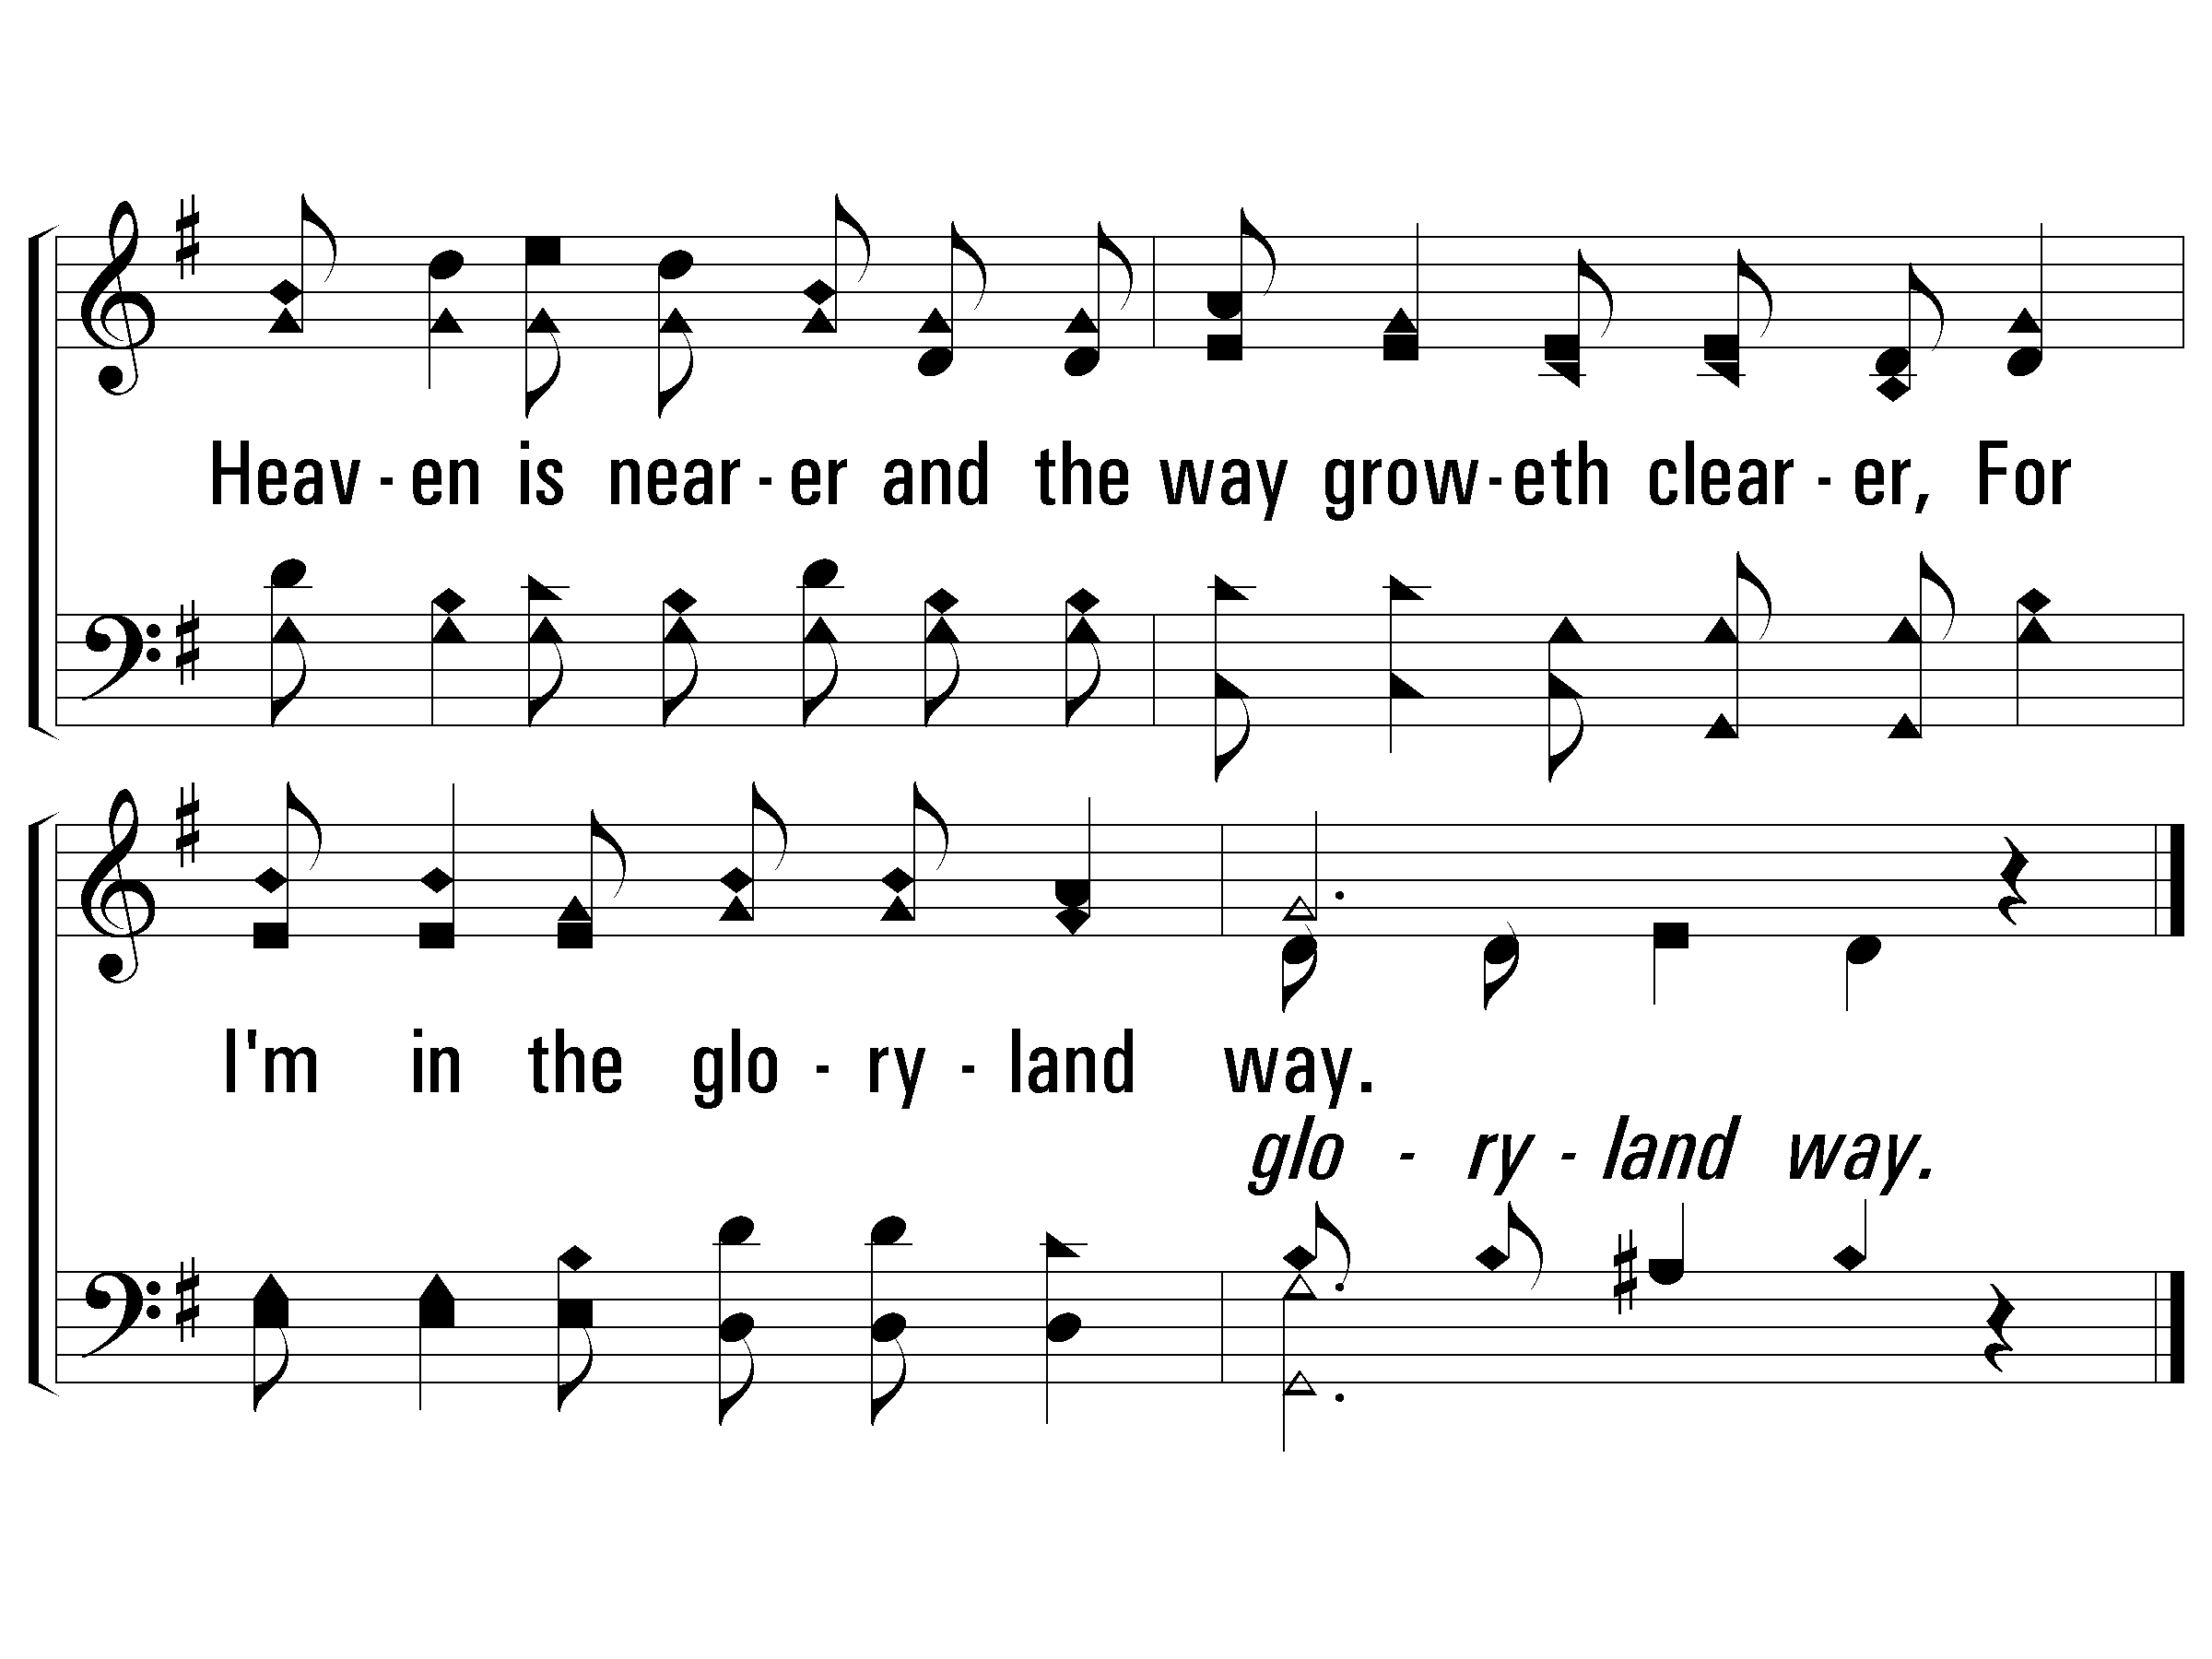
c – The Glory-Land Way
© 2001 The Paperless Hymnal™

Slide 25
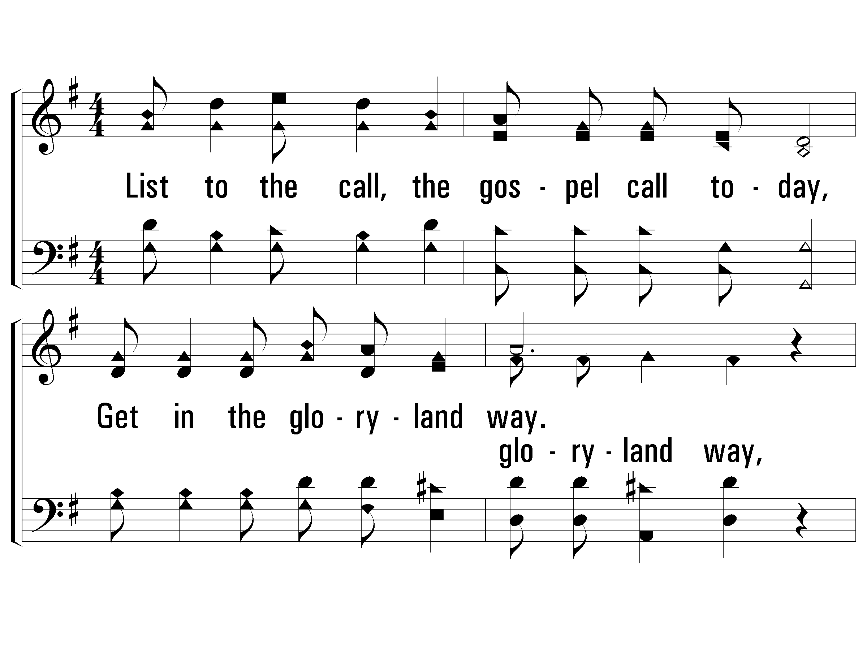
2 – The Glory-Land Way
2.
List to the call, the gospel call today,
Get in the gloryland way;
Wanderers, come home, O hasten to obey,
For I'm in the gloryland way.
Words and Music by: J. S. Torbett
© 2001 The Paperless Hymnal™

Slide 26
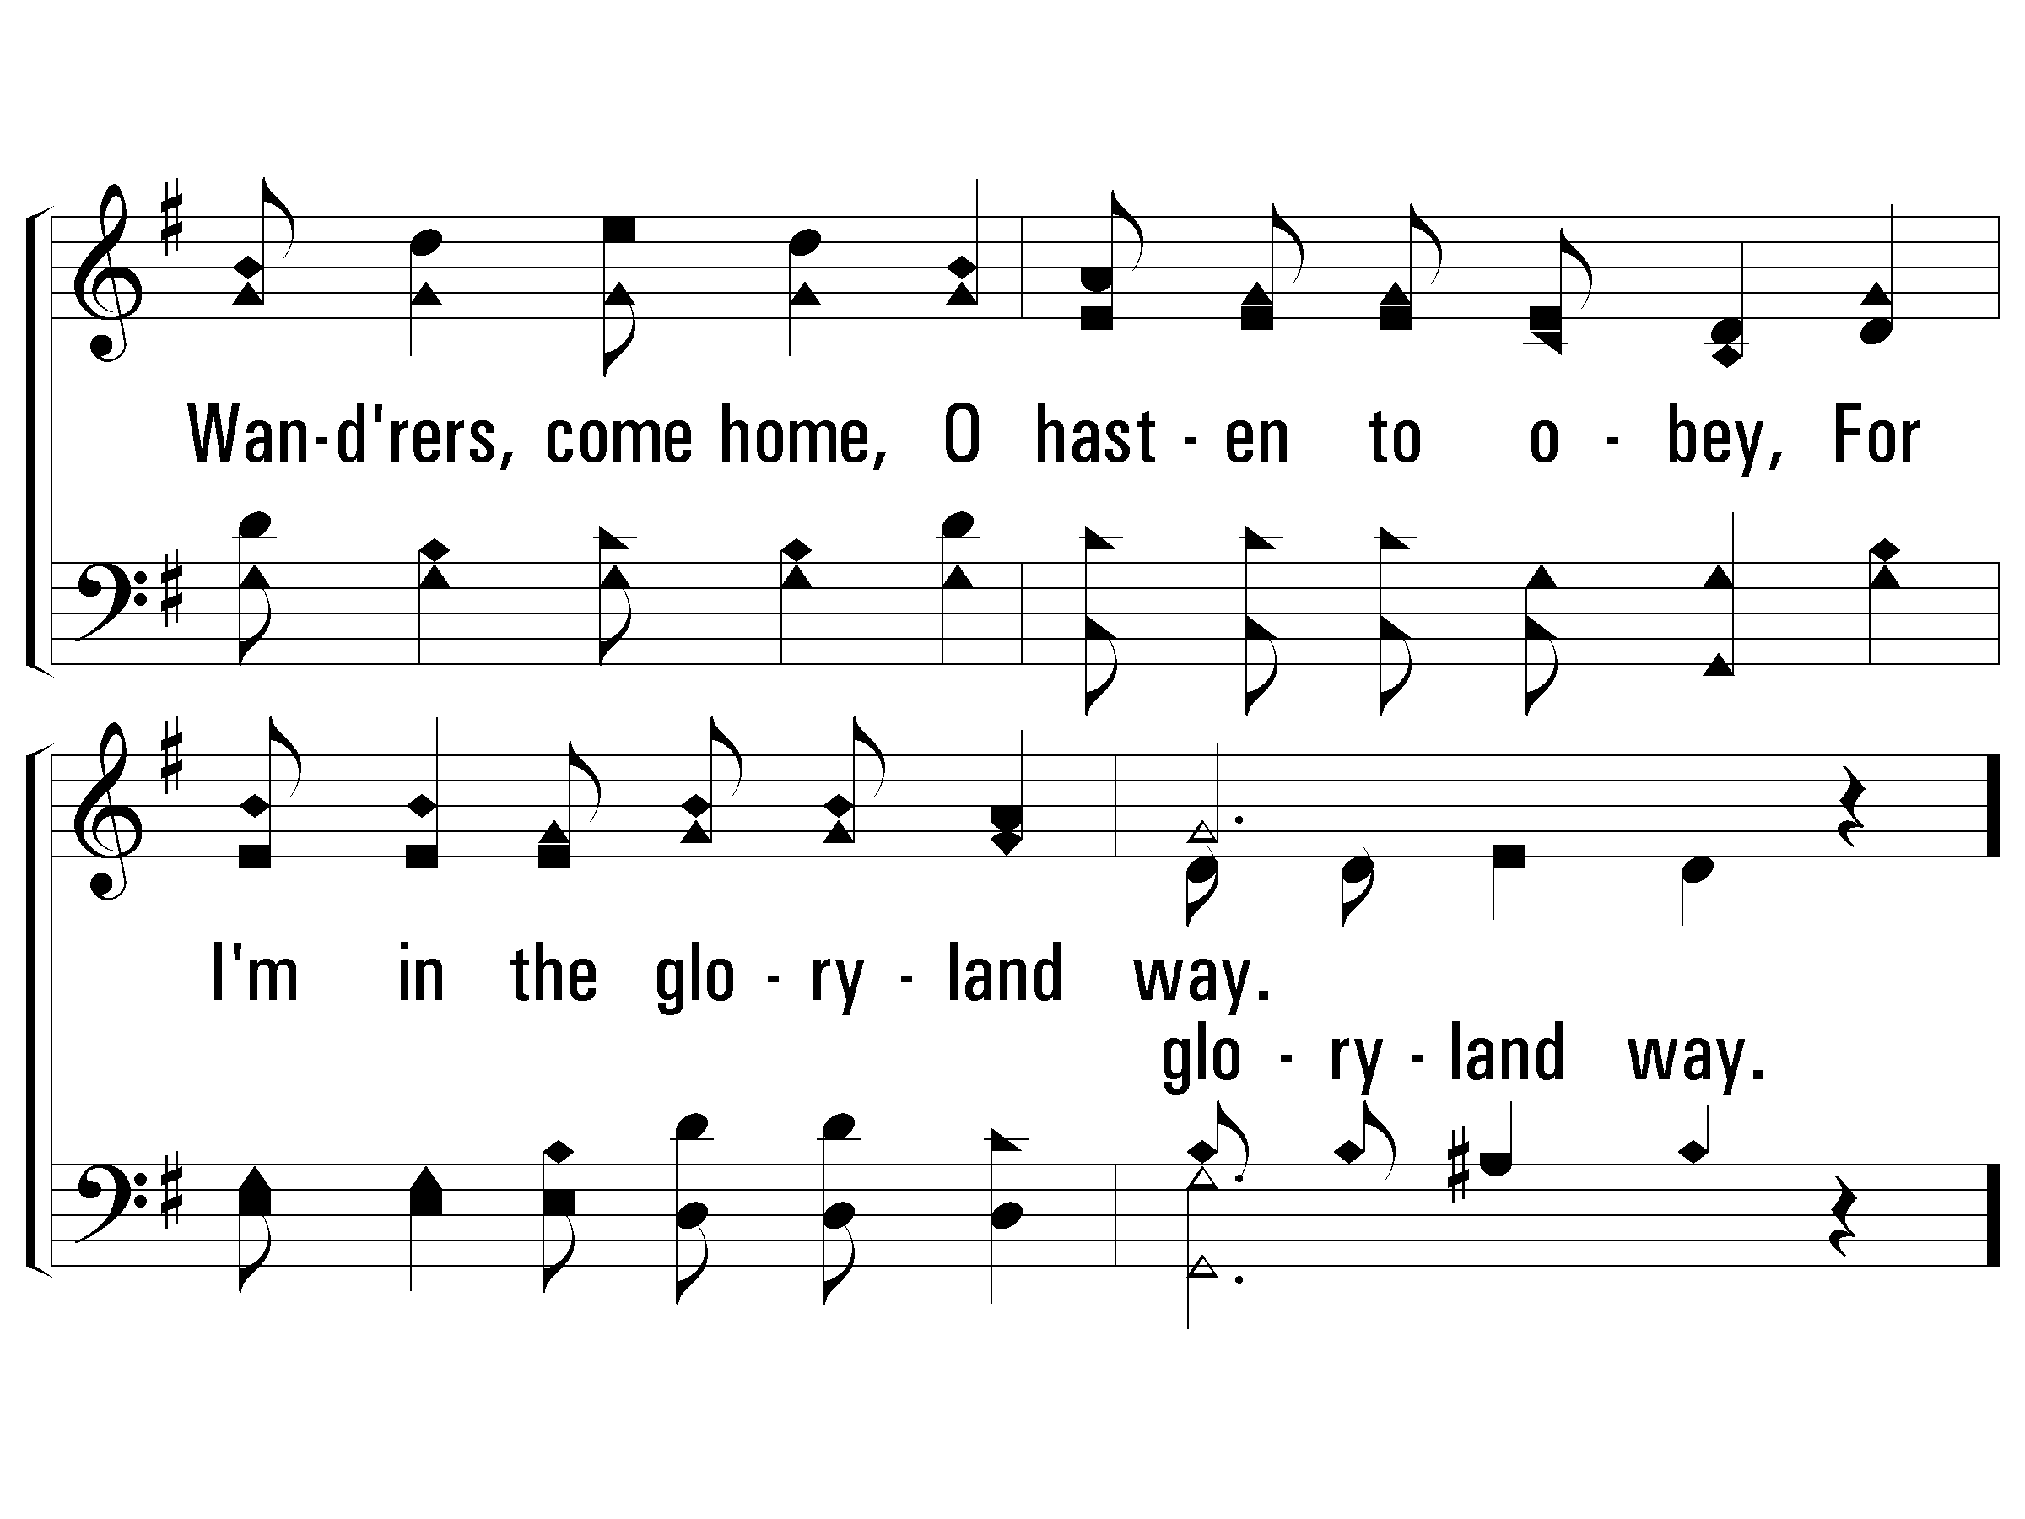
2 – The Glory-Land Way
© 2001 The Paperless Hymnal™

Slide 27
c – The Glory-Land Way
I'm in the gloryland way,
I'm in the gloryland way;
Heaven is nearer and the way groweth clearer,
For I'm in the gloryland way.
© 2001 The Paperless Hymnal™

Slide 28
c – The Glory-Land Way
© 2001 The Paperless Hymnal™

Slide 29
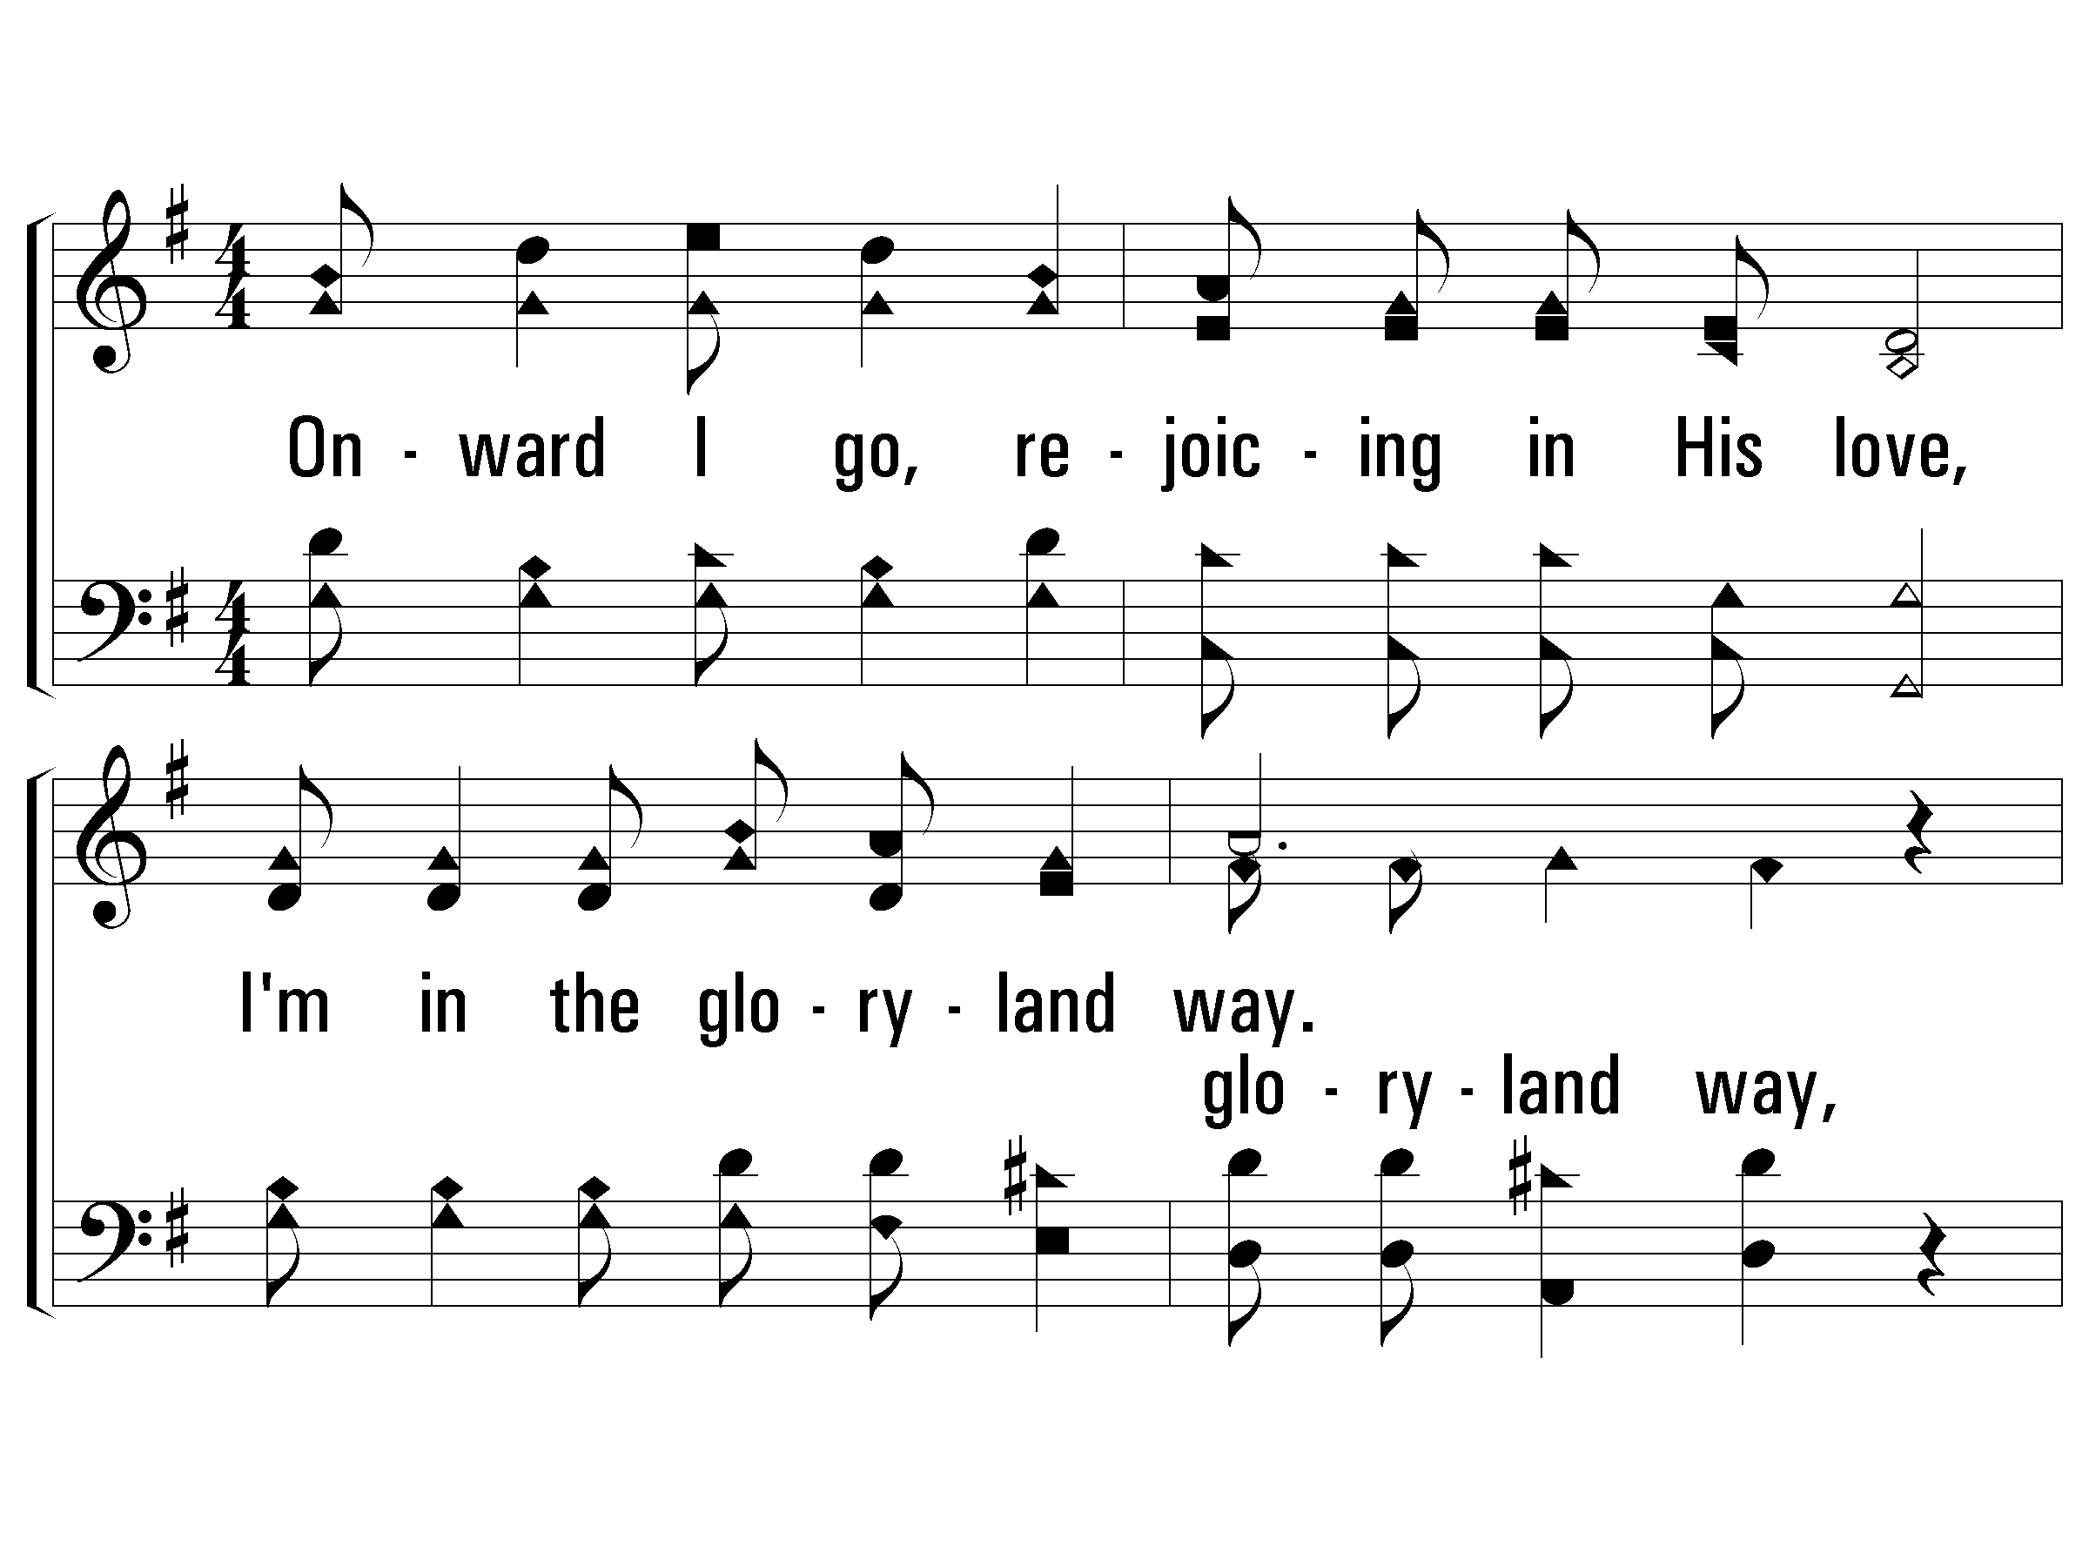
3 – The Glory-Land Way
3.
Onward I go, rejoicing in His love,
I'm in the gloryland way;
Soon I shall see Him in that home above,
O I'm in the gloryland way.
Words and Music by: J. S. Torbett
© 2001 The Paperless Hymnal™

Slide 30
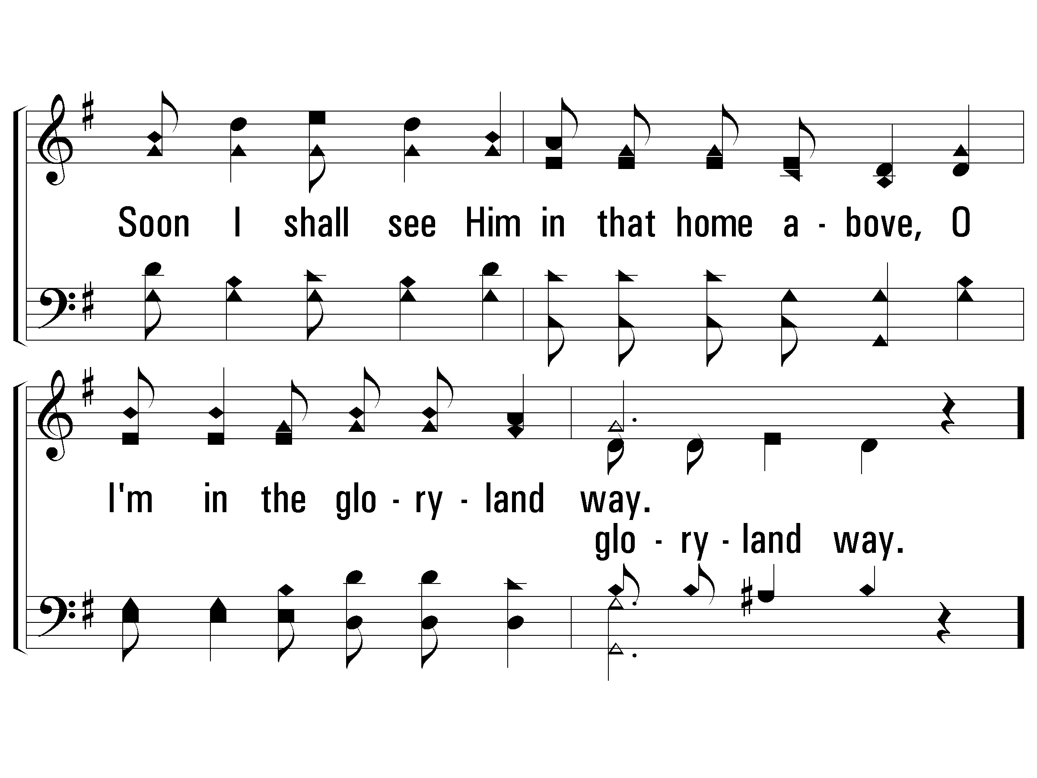
3 – The Glory-Land Way
© 2001 The Paperless Hymnal™

Slide 31
c – The Glory-Land Way
I'm in the gloryland way,
I'm in the gloryland way;
Heaven is nearer and the way groweth clearer,
For I'm in the gloryland way.
© 2001 The Paperless Hymnal™

Slide 32
c – The Glory-Land Way
© 2001 The Paperless Hymnal™

Slide 35
1. START WITH YOU. YOU ARE YOUR TOUGHEST LEADERSHIP CHALLENGE.

Slide 36
2. SABATTH. RETREAT WITH YOUR WIFE. RETREAT WITH YOUR KIDS.

Slide 37
3. EFFECTIVE MINISTRY CASTS, IMPLEMENTS, & REEVALUATES VISION.

Slide 38
4. CREATE A “MADE FOR MONDAY’S” MENTALITY.

Slide 39
5. CREATE A CULTURE OF PRAYER.

Slide 40
6. EFFECTIVE MINISTRY INVESTS IN PROFESSIONAL DEVELOPMENT.

Slide 41
7. IMPLEMENT INCLUSIVE GOSPEL-CENTERED TEACHING.

Slide 42
8. EFFECTIVE MINISTRY DEVELOPS A CULTURE OF CONTRIBUTION NOT CONSUMPTION.

Slide 45
Lessons from the pandemic…
1. OUR TRUE IDENTITY HAS BEEN BROUGHT TO THE SURFACE.

Slide 46
Lessons from the pandemic…
2. THE CHURCH SHOULD BE ON THE FRONT LINES.

Slide 47
Lessons from the pandemic…
3. RETHINK YOUR FACILITIES FOR EMERGING OPPORTUNITIES.

Slide 48
Lessons from the pandemic…
4. WE HAD TO LEARN TO PIVOT NOT PANIC.

Slide 49
Lessons from the pandemic…
5. SEIZE THE OPPORTUNITY TO REACH THE DIGITAL WORLD.

Slide 50
Lessons from the pandemic…
6. THE CHURCH NEEDS TO EXPERINCE COMMUNITY.

Slide 51
Lessons from the pandemic…
7. THE CHURCH IS RESILIENT.

